Slide 1
ABW ONLINE SERVER RACK HOME CLOUD SERVERS WINDOWS BASED PHP FTP CLOUD E-MAIL AND MORE CUSTOM ORDERED
SERVER DESKTOP CHASIE BUILD XP WINDOWS SERVER WINDOWS 8 2012 R2 SQL PHP CLOUD AARON WEST OF ABW ONLINE PARTS AND ORDERING WINDOWS SERVER SATA HDD SERVER CHASIES TO PASS AARONS BOREDOM ON DISABILITY NEED UNDER THE TABLE WORK PAYABLE WESTERN UNION NOT THROUGH MY ACCOUNT CAUSE OF DISABILITY
PARTS AND ORDERING TABLE TO CUSTOM MAKE YOUR OWN DESKTOP SERVER WORK NETWORK SUSTAIN A DOMAIN CLOUD USING ABWONLINE DOMAIN ENTERPRISE CLOUD TO WEBHOST YOUR OWN CLOUD USING ENTERPRISE SOFTWARE CLOUD. I CHEATED THE CLOUD IS A ENTERPRISE DEPLOYMENT YOUR SOFTWARE IS BENEATH MY ADMIN I WANT MY FAMILY TO BE THE HIGHEST OF MY ADMIN SERVERS ASS THE FIRST LONG DISTANCE CLOUD BASED SERVER RACK WORK NETWORKS OFFERING DOMAINS AND FTP PHP SQL OFFICE ALL WINDOWS AND WHM AND MORE PLUS ALSO WEBHOST COMPILERS . I WANNA BUILD THE FIRST STATION AT MY MOMS. SECOND STATION I MAIL OUT YOU PLUG IN IF ANY PROBLAMS I COME VISIT A WEEK OR SO TO FIX IT NOT HARD

Slide 39
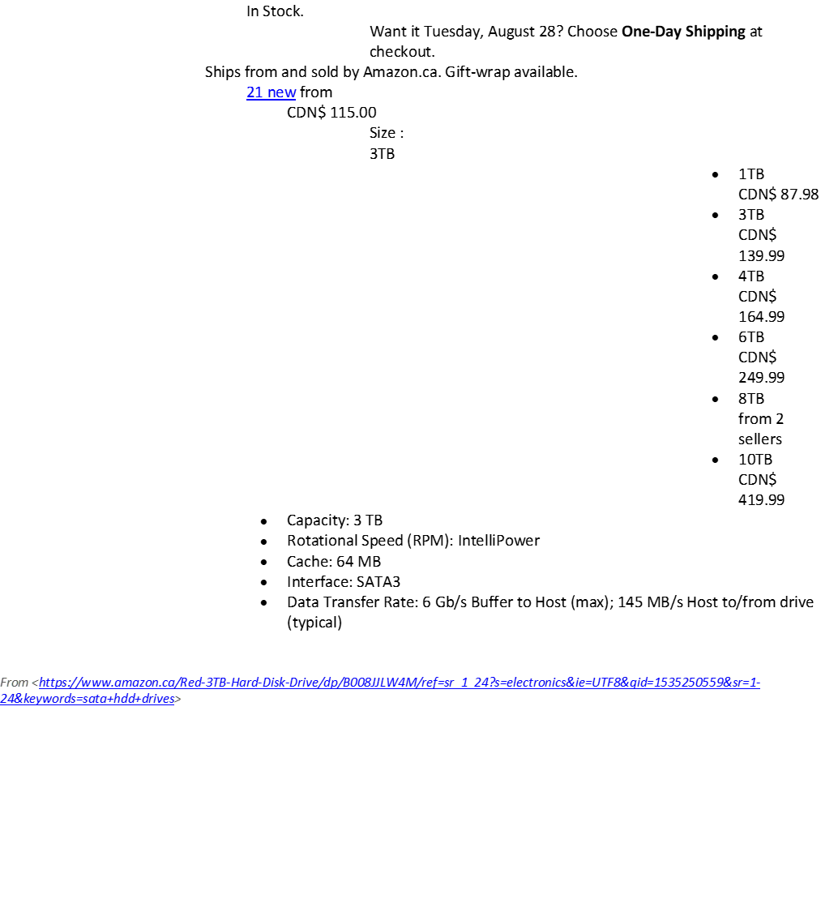
ADDED SUMS TO THE SET SERVER RACK PRICE OF $630.00 ABWONLINE CLOUD SERVER RACKS FOR WINDOWS DESKTOP HOME WORK NETWORKS TO CLOUD TO ALL COMPUTERS AS A APP AT MOMS CODE SERVER ABW ONLINE MOM’S SAFE
ADD POWER SUPLY STAND ALONE SERVER ADDITIONAL CHARGE $110
ADDITIONAL SATA RAID NAS MEMORY HARD DRIVES HDD DRIVES ADDED CHARGES ADDITIONAL MEMORY CHARGES CLOUD WORKLOAD CHOICES
THE CURRENT 630.00 MODEL IS BUILT FOR ATACHING TO DESK TOPS TO CLOUD THEIR SYSTEM AS A HOME WORK NETWORK CLOUD AS ONE MASTER APP AND SERVER NETWORK ETHERNET CLOUD WORK NETWORK ENTERPRISE THAT SMALL BUSINESSES CAN ATTACH A DESKTOP TO A SERVER RACK CLOUD FOR HOME CLOUD WERE THE MASTER RACK AT 3667 INVERNESS HANDLES THE SAFE OF THE AARON APP CLOUD SERVER SOFTWARE SIMPLE WINDOWS SOFTWARE FOR ACHIVEING INDEX THAT ALLOWS OFFICE POWERPOINT SQL FTP SFTP AND EVEN A EMAIL CENTER ALSO PHP AS A MASTER SERVER ABW ONLINE. THE CURRENT MODEL IS A SERVER CONTROL NETWORK OF SOFTWARE ENTERPRISE THAT PUTS ALL ABW ONLINE CLIENTS INTO A CLIENT DATA BASE BY DCHP ACCOUNT FOR ALL COMPUTERS. THE POWER IS SPLIT TOTAL OF THE DESK TOP OR ADD A POWER SUPPLY FOR $110. PREFERABLY MY SERVER RACK WORKS BEST SPLIT POWER OF DESK TOP FOR POWER TOTAL OF ALL PINS TO TOTAL YOUR DESK TOP WITH YOUR CLOUD ALL ABW ONLINE SERVER RACKS COME WITH ADDITIONAL SOFTWARE CHOICES AT ADDED CHARGES SEE SOFTWARE SETUP SALES SHEETS ADDED CHARGE LIST SOFTWARE MANDATORY AT SALE ALL CHARGES ARE AT COST CHARGE LIST AND INCLUDES ADDITIONAL CHARGES OF ALL LABOUR TO PUT TOGETHER ALL SERVER CLOUD RACKS. CUSTOM CLOUD RACK TAKES UP TO 3 MONTHS TO BUILD IF ALL IS INCLUDED OR SERVER RACK OVER MODIFIED TO SPECIFICATIONS. THIS RACK IS A BASIC SERVER CLOUD ENTERPRISE DESKTOP RACK FOR ALL USERS IDEAL FOR HOMES WITH FAMILIES AND WORKPLACES THAT ARE 16 TB PER SERVER RACK MAXIMUM

Slide 40
WINDOWS BASED RUNNING SOFTWARE WINDOWS SERVER CAN DEPLOY TO ANY WINDOWS SOFTWARE FROM THE SERVER CLOUD DEVICES WITH SDK DISKS I MAKE WHICH IS A SYSTEM SYSTEM DOWNLOAD KIT THAT I MAKE TO DEPLOY THE SERVER TO THE WINDOWS COMPUTER FOR REMOTEING AND NETWORKING WHICH DEPLOYS A NETWORK FOLDER YOUR CLOUD BUT ALSO DISPLAYS YOUR DOMAIN FTP AND SERVER ONLINE AS WELL FROM ANY LAPTOP TABLET DESKTOP OR EVEN PHONE
WINDOWS SOFTWARE PRICEING
-WINDOWS 10 $87.75
-WINDOWS 10 ENTERPRISE $77.00
-WINDOWS 8 ENTERPRISE 74.25
-WINDOWS 7 ULTIMATE 81.00
-WINDOWS VISTA 81.00
-WINDOWS XP PROFFESSIONAL $74.25
-WINDOWS SERVER 2016 DATA CENTER $101.25
-WINDOWS SERVER 2012 R2 DATA CENTER $97.88
-WINDOWS SERVER 2003 ENTERPRISE R2 $74.25
-WIN OFFICE 2016 $87.75 YR.
-MAC OFFICE 2016 94.50
-PROJECT 2016 PROFESIONAL 84.38
-VISIO 2016 PRO $84.38

